Slide 1
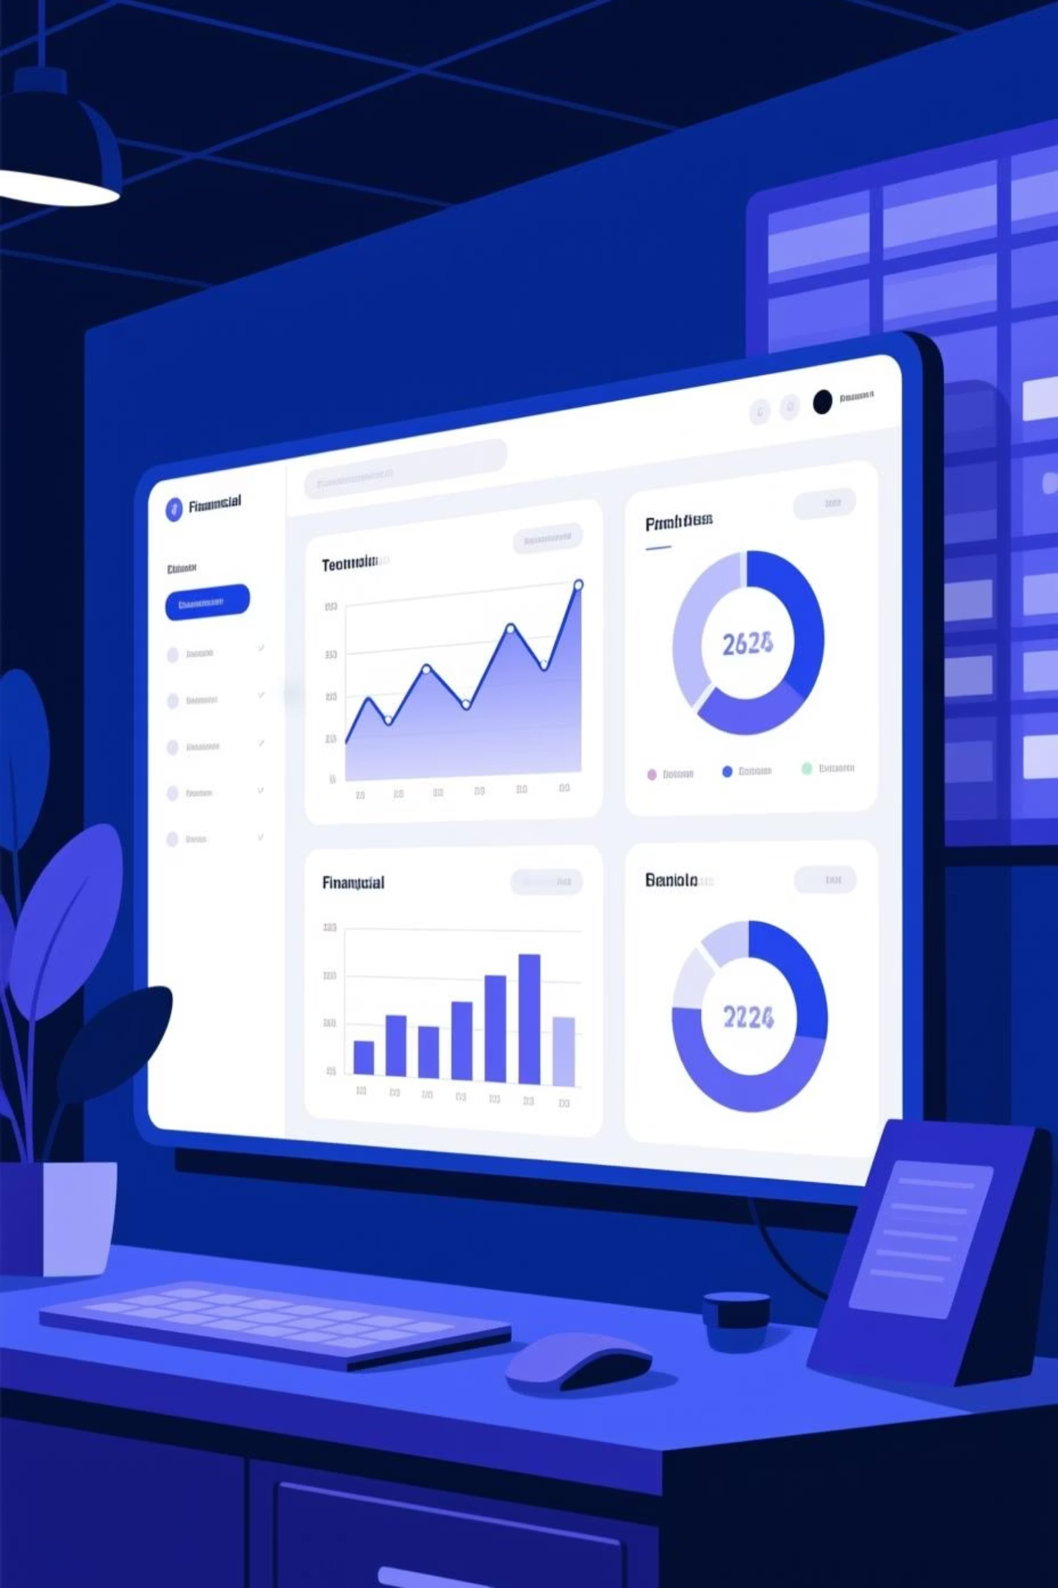
Portfolio Risk & Claims Intelligence System
Transforming Raw Data into Intelligent, Actionable Decisions
By: Niket. Talikoti

Slide 2





About FinSight Orion
Pan-India Operations
Modern financial services company with nationwide presence across multiple regions
Diverse Product Suite
Comprehensive offerings including loans, insurance products, and asset financing solutions
Multi-Channel Distribution
Seamless customer access via Mobile App, Branch Networks, Brokers, and Dealer Partners
Data-Driven Focus
Strong emphasis on risk analytics and delivering customer-centric financial solutions

Slide 3

Project Objective
The mission was clear: transform fragmented transactional data into a unified strategic intelligence system that empowers decision-makers with real-time insights.
01
Unified Risk System
Build an integrated risk and claims intelligence platform consolidating all data sources
02
Deep SQL Analysis
Analyze 10,000+ contracts using advanced SQL queries to extract meaningful patterns
03
Power BI Visualization
Create interactive dashboards visualizing defaults, claims, and profitability metrics
04
Actionable Insights
Identify core risk drivers and uncover strategic improvement opportunities

Slide 4
Portfolio Overview
A comprehensive snapshot of our financial ecosystem reveals strong volume with notable risk exposure
10K
2K
24%
222
Total Contracts
Total Defaults
Default Rate
Total Claims
Active agreements across all product lines
Contracts currently in default status
Portfolio-wide default percentage
Insurance claims filed to date
2.2%
3B
Claim Rate
Estimated Profit
Claims as percentage of contracts
Total profitability across portfolio
Despite elevated default rates, high-value loan and lease products sustain strong profitability, with claims remaining relatively rare at just over 2% of contracts.

Slide 5

Portfolio Distribution
Product Mix
Regional Footprint
Vehicle Insurance dominates portfolio volume with largest contract count
North, South & West regions hold majority of active contracts
Loans & Equipment Insurance form strong commercial revenue segments
These three regions serve as primary business hubs
East & Central show smaller but stable footprint
Operating leases contribute to diversified product ecosystem
Regional diversity provides growth opportunities and risk mitigation
Balanced mix supports risk distribution across asset classes

Slide 6
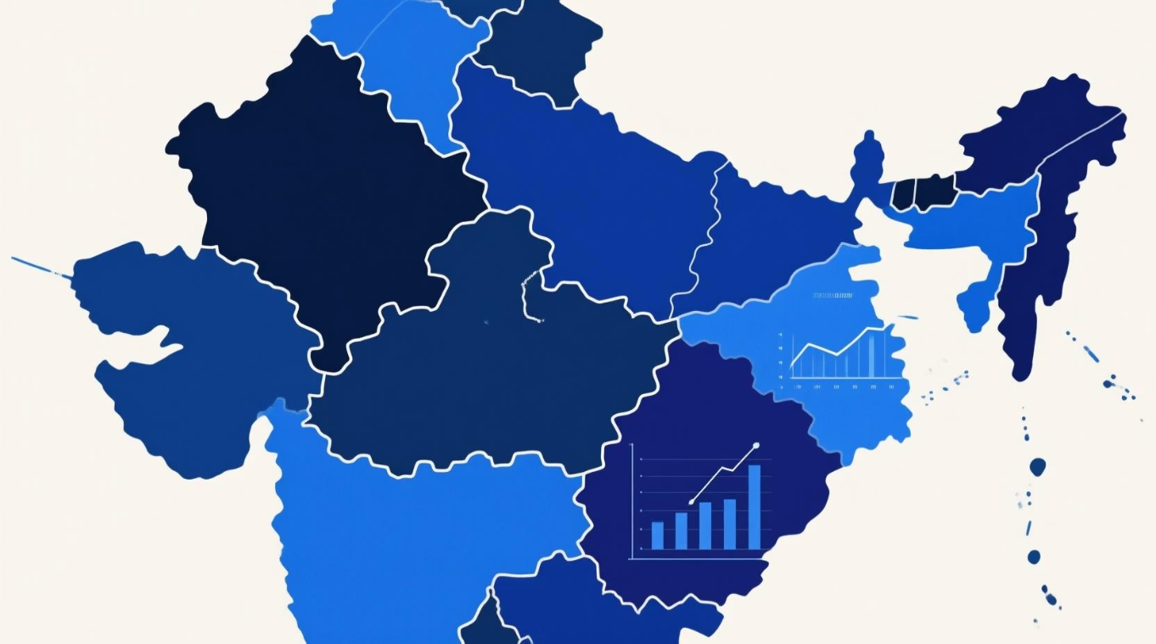
Default Behavior by Region
Geographic analysis reveals significant variations in repayment discipline across our operating regions
South Region
North Region
25.3%
24.2%
Highest default rate – requires enhanced underwriting controls and collection strategies
Above-average default rate indicating moderate risk exposure
West Region
East Region
23.8%
22.8%
Near portfolio average with stable performance patterns
Lowest default rate – demonstrates strongest repayment discipline
The East region consistently outperforms with superior repayment behavior, while the South emerges as the highest-risk geography. Regional strategies and local economic conditions significantly influence default patterns.

Slide 7
Credit Score: The Strongest Risk Predictor
Credit score analysis reveals it as the single most powerful predictor of default behavior across our portfolio.
36.8%
15%
Score <600
Score 600-700
Customers with scores below 600 default at more than twice the rate of medium-score customers, providing clear evidence for risk-based pricing and underwriting decisions.
High-risk segment with elevated default probability
Medium-risk segment showing strong repayment discipline
26.7%
Score >700
Premium segment with moderate risk levels

Slide 8
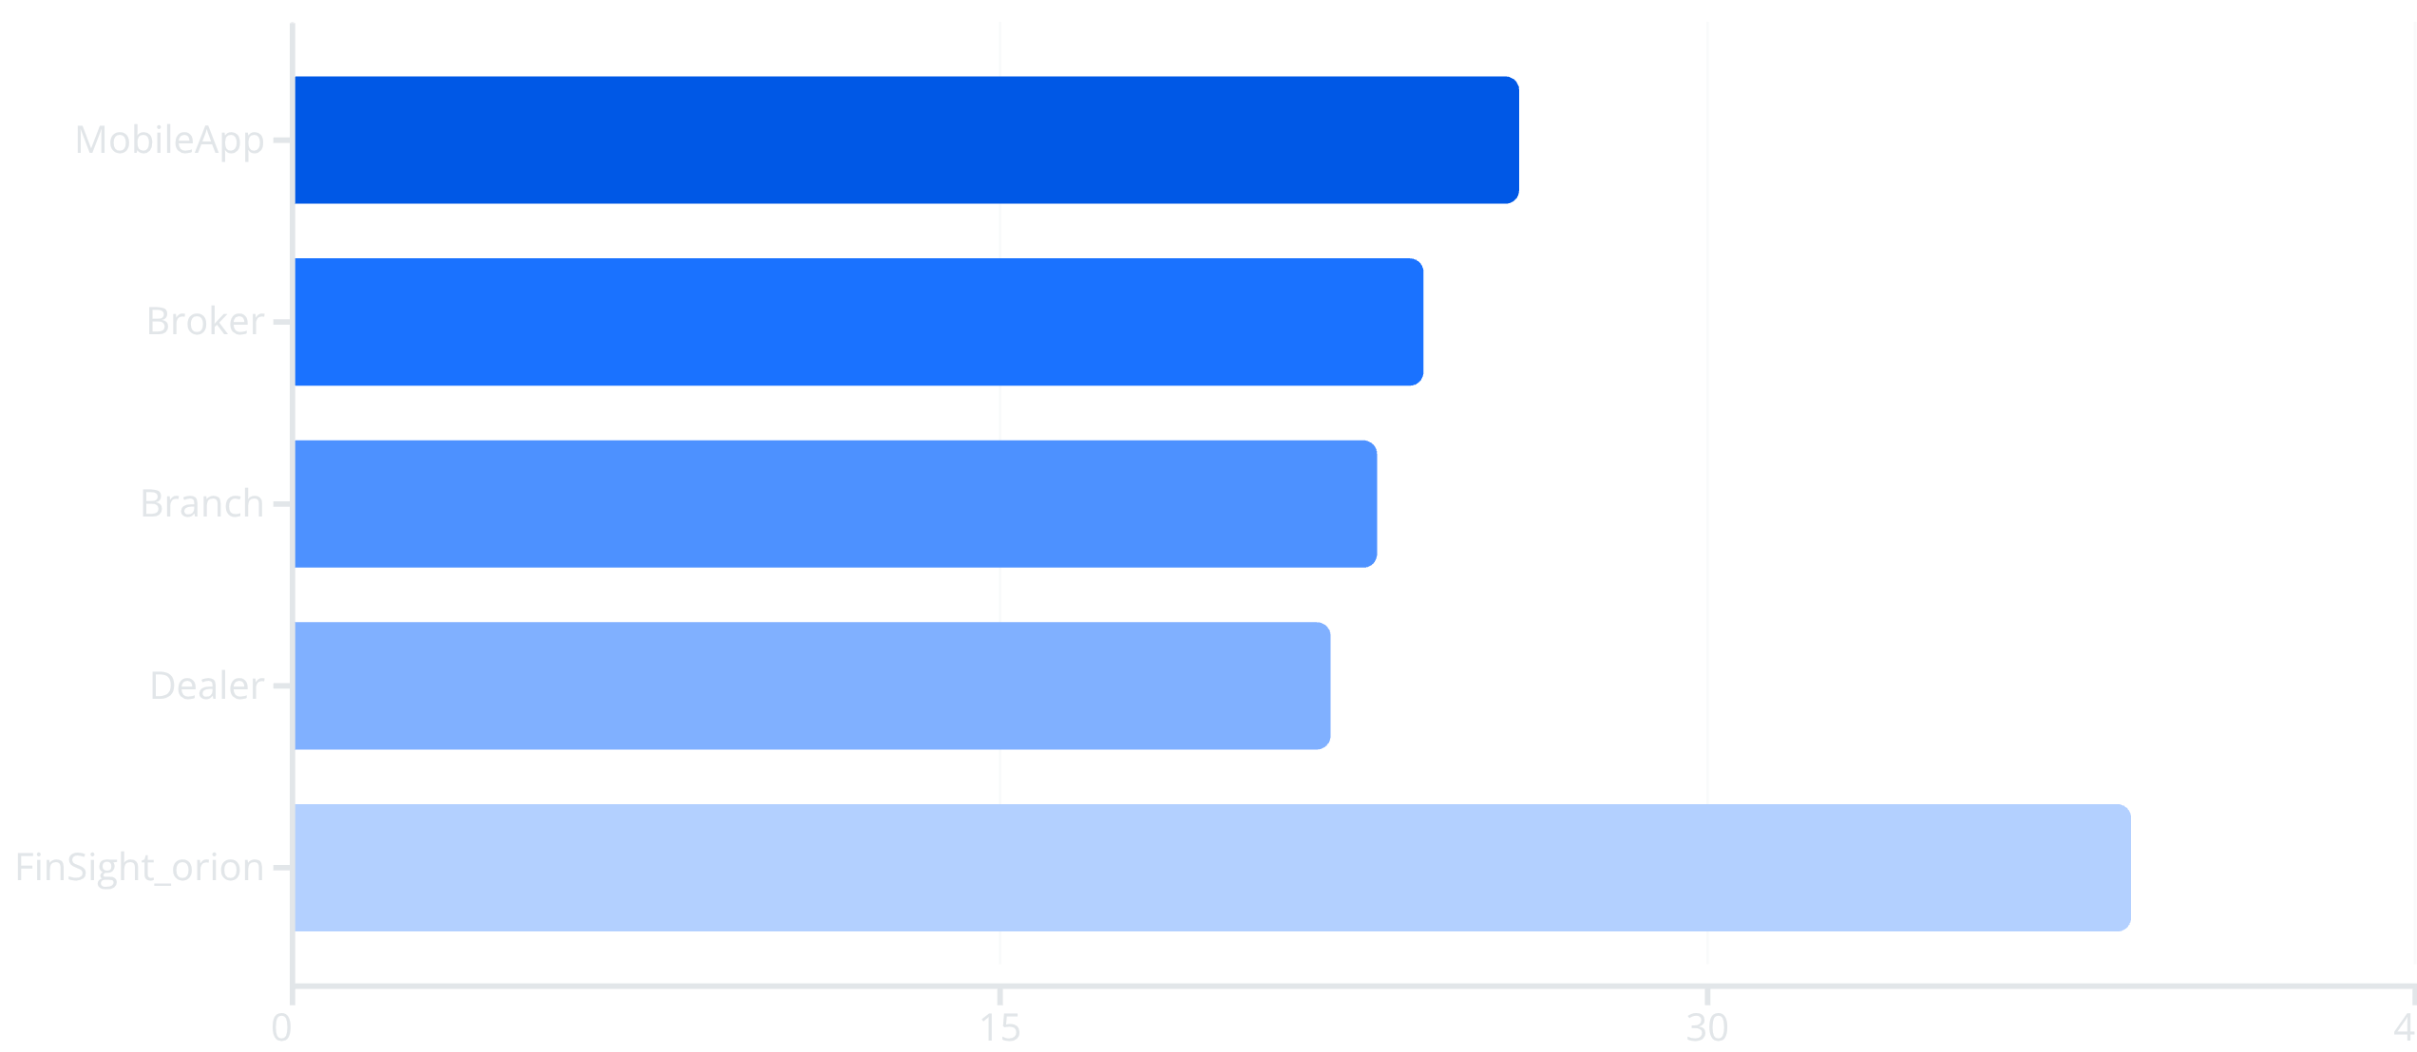

Channel-Level Risk Intelligence
Origination channel analysis uncovers critical risk variations and a concerning outlier demanding immediate attention
⚠️ Critical Finding
The FinSight_orion channel shows a dangerous 39% default rate – significantly higher than all other channels. This outlier requires immediate investigation to identify potential onboarding flaws, fraudulent behavior patterns, or systemic underwriting weaknesses.

Slide 9

Claims Severity & Profitability Dynamics
Claims by Asset Type
Claims remain rare but concentrate in specific asset categories:
Profitability Intelligence
3.66%
Cars
Highest claim rate
2.95%
Trucks
Elevated claims
1.8%
Property
Low claim rate
1.5%
Estimated Total Profit: 27.49M
Equipment
A small subset of high-value contracts drives majority of earnings
Vehicle Insurance emerges as major source of loss-making contracts
Minimal claims
High-value loans and leases sustain overall portfolio profitability
Mobile assets like cars and trucks dominate claim occurrences due to higher usage and accident exposure.
Uneven profit distribution requires strategic product pricing review

Slide 10
Key Insights & Strategic Recommendations
1
2
3
Portfolio Ecosystem
Credit Score Priority
Vehicle Insurance Reset
The portfolio behaves like a living organism with distinct risk zones. West and North regions function as "storm zones" with elevated default concentrations.
Strengthen underwriting rules for customers with credit scores below 600 – the single strongest risk predictor requiring immediate tightening.
Reassess Vehicle Insurance pricing models and claims handling procedures to address loss-making contract concentration.
4
5
6
Channel Audit
Geographic Expansion
Predictive Systems
Conduct urgent investigation of FinSight_orion channel's 39% default rate to identify systemic issues and implement corrective measures.
Expand presence in high-performing East region while implementing enhanced controls in South region.
Build risk-based customer segmentation models and implement early warning systems for delinquency detection.
FinSight Orion connects SQL-driven insights with real-time BI intelligence, providing unprecedented visibility into risk, claims, and profitability. This integrated system enables data-driven decision-making and sets the foundation for advanced predictive modeling capabilities.

Slide 11





Conclusion
FinSight Orion successfully transformed a complex portfolio into a clear, data-driven story, combining SQL-based analytics with a dynamic Power BI intelligence layer to reveal:
Risk Origins
Default Drivers
Profitability Levers
Precisely identified where risk originates within the portfolio.
Uncovered the core reasons why customers default on their contracts.
Highlighted which specific products drive overall profitability.
Claims Impact
Targeted Action
Detailed how claims impact the business's financial health.
Pinpointed specific channels and regions requiring immediate attention.
The insights make one message very clear: With the right segmentation, stronger underwriting controls, and targeted channel discipline, the organization can shift from reactive risk management to proactive, predictive decision-making. FinSight Orion provides the foundation for that transformation—turning raw data into intelligence, and intelligence into smarter, faster, safer business decisions.

